Slide 1

What is big data? What is machine learning?
Hands on with the new BSSS Data Science course

Slide 2
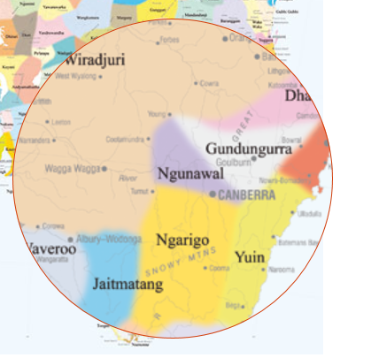
Acknowledgement of Country

Slide 3
Overview
We will look at the structure of the Data Science Course
We will explore Data Analysis and Visualisation using Python
We will have a look at Google's AIY platform
Questions welcome at any time

Slide 4
The Data Science Course
Background
Australian Technologies Curriculum
Changing IT landscape
Rationale
4 units per course
Students select an individual DT major

Slide 5
The Data Science Course
Data Representation and Analysis
Big Data Analysis and Techniques
Machine Learning
Data Research Project

Slide 6
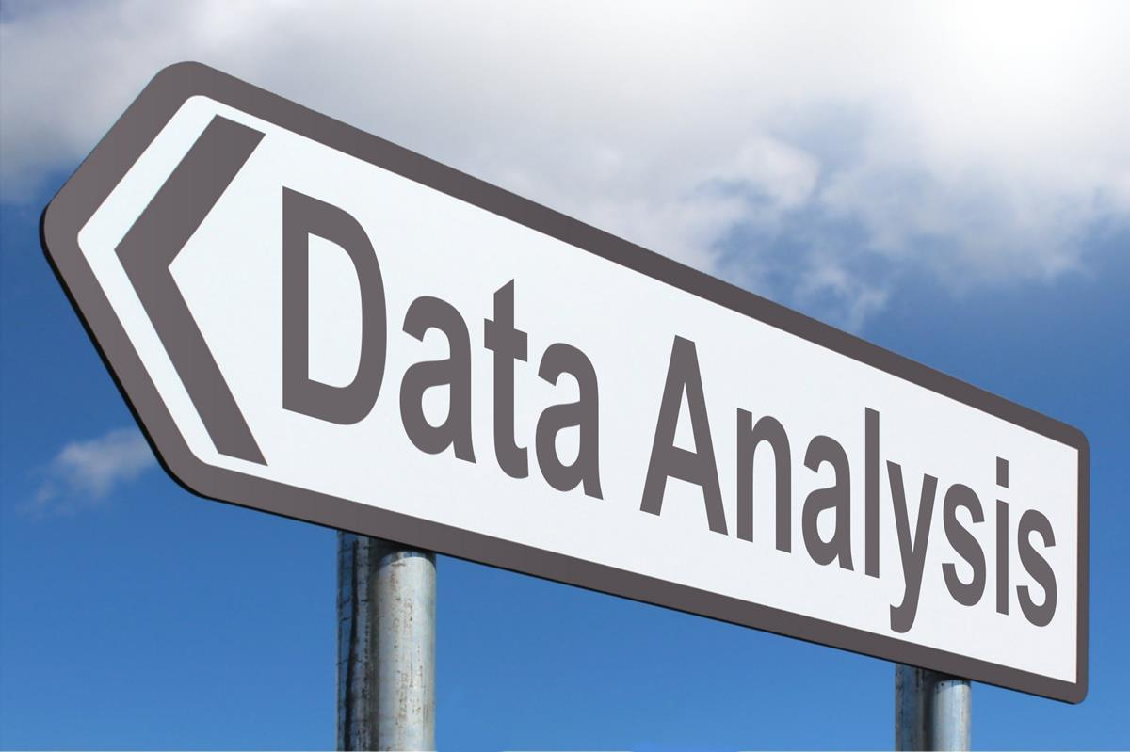
Data Representation and Analysis
This unit explores the ways that digital information is encoded, represented, manipulated, stored, compressed and transmitted. Understanding where data comes from, having intuitions about what could be learned or extracted from it, being able to use computational tools to digitally manipulate data, visualise it and identifying patterns, trends, and to use data to develop narratives and arguments are the primary skills addressed in the unit.
How is data represented?
How is data collected?
How is encoded?
How is it stored?
How does it travel and how is it communicated?
What patterns does the data reveal? How can the data be used to tell a story?

Slide 7
Can I teach Data Representation and Analysis?
YES!
You can use spreadsheets and databases!
You can use Google forms
You can collect data from sensors on Arduinos/microprocessors
You can use the knowledge you already have about data and systems
You can help students to use technology to develop strong narratives about data

Slide 8
Why isn't this just Spreadsheets and Databases?
You can take it further
Talk about how data is used, and abused
Talk about privacy, control and social agendas
Lies, damned lies, and statistics - we need students to understand how data is abused, and how it can be used effectively and persuasively
You can take it further in programming:
Look at ways of transforming data, shaping data, and creating narratives using data visualisations
https://guns.periscopic.com/?year=2013

Slide 9
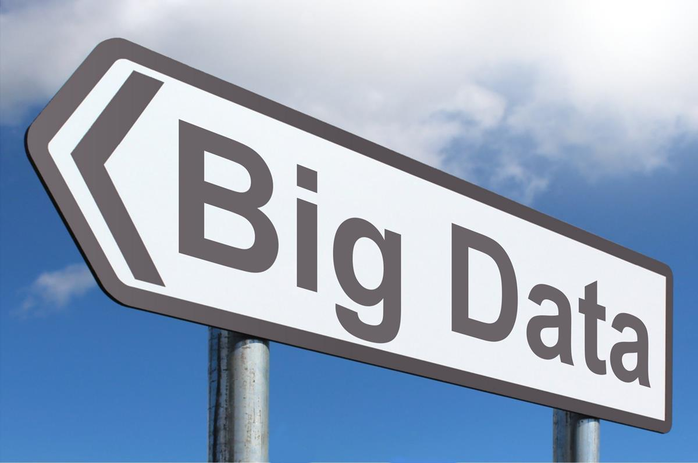
Big Data Analysis and Techniques
The data-rich world that we live in introduces many complex questions related to public policy, law, ethics and social impact. The goals of this unit are to develop a well-rounded and
balanced view about data in the world, including the positive and negative effects of it. Students will develop skills in using data analysis processes, relevant algorithms and techniques and computational tools to analyse Big Data using a multidisciplinary approach.
Big Data is defined by 3 Vs:
Volume (too large for a single computer hard disk)
Velocity (too much data over a network in a short period of time)
Variety (a wide variety of data formats, or less structured data)

Slide 10
Can we deal with Big Data in a Classroom?
We can address the concepts and skills required for analysing big data
We can access publicly available big data sets
We can access free / low cost cloud based computing services (AWS, MS Azure, Google Cloud)
https://data.gov.au/
https://github.com/awesomedata/awesome-public-datasets
https://aws.amazon.com/datasets/google-books-ngrams/

Slide 11
Can I Teach Big Data
Big Data requires programming skills: Python is recommended - lots of tools/libraries
Attend PL offered by InTEACT
Study via MOOCs
Read Books and Articles:
Videos:
The secret life of big data:
https://youtu.be/CNoi-XqwJnA
O’Neil,Cathy(2016) Weapons of math destruction: how big data increases inequality and threatens democracy. New York: Penguin
Calude, Christian S & Longo, Giuseppe(2017) The deluge of spurious correlations in big data. Foundations of Science, 22(3) pp. 595-612. Available at: https://www.di.ens.fr/users/longo/files/BigData-Calude-LongoAug21.pdf
Kelleher, John D & Tierney, Brendan(2018) Data Science. Cambridge, MA: MIT Press.
Walsh, Bryan(2014) Your data is dirty: the carbon price of cloud computing. Available at: http://time.com/46777/your-data-is-dirty-the-carbon-price-of-cloud-computing
Zuboff, Shoshana(2015) Big other: surveillance capitalism and the prospects of an information civilization. Journal of Information Technology, 30, p. 75-89.

Slide 12
What are the Main concepts of Big Data?
Too big for one computer to handle
will not fit on hard drive
will not fit in RAM
may take too long to process
Multiple computers and clustered storage required
Parallel processing techniques enable efficient scaling
MapReduce is one of the key elements

Slide 13
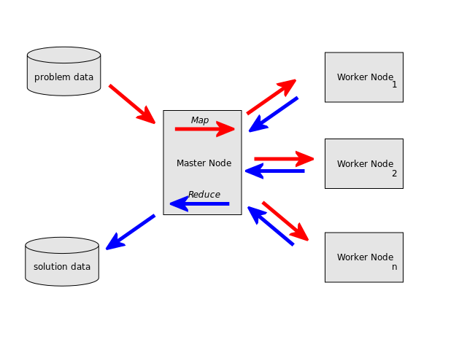
MapReduce
Map Reduce is a techniques from the functional programming paradigm
Functional programming:
Not imperative
Not state-based
No change to data (immutable data)
Order of execution is unimportant
Because of this it is extremely powerful for parallel/distributed computing

Slide 14
MapReduce
Based on 2 functions: Map and Reduce
Map maps a given function to a set of data (represented as a list) creating a new set of transformed data. This can be used to order (sort), slice, or filter a dataset.The original dataset remains unchanged.
Reduce applies a function to a data set to accumulate data. This can be used to perform statistical analysis on a dataset. This creates a new associative dataset.
Sometimes a "shuffle" or partition step is placed in-between in order to assign slices of the data to specific processors.

Slide 15
Big Data - Going Deeper
Uses and Applications of Big Data Analytics
Handling qualitative data, unstructured data, visual, audio and video data
Managing and cleaning dirty data
Trust and Security
Signal to noise ratios
Real-time data
SKA

Slide 16

Machine Learning
Machine Learning (ML) is an area of Artificial Intelligence which uses autonomous, simulated learning models and large data sets to develop models for prediction, analysis, diagnosis and recommendation. Students will develop an understanding of ML, different learning models, and statistical pattern recognition. Students will learn how to apply models of supervised and unsupervised learning. They will apply learning algorithms to
analyse datasets from a range of authentic sources relevant to contemporary contexts. Students will learn how selection of training data can skew the results of the machine learning system. They will be able to build models or applications which enable predictions or recommendations, contextualising the social impact of their ML application.
ML is one application (subset) or Artificial Intelligence
ML is being applied to data everywhere
ML is here to stay

Slide 17
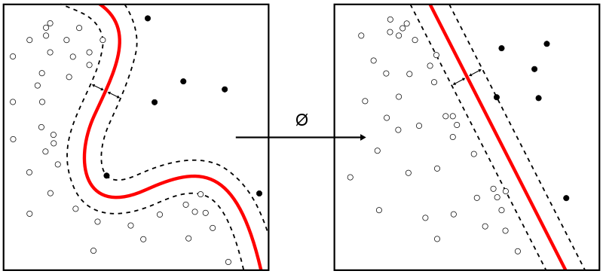
Types of ML
Bayesian
https://towardsdatascience.com/ml-algorithms-one-sd-%CF%83-bayesian-algorithms-b59785da792a
SVM
https://en.wikipedia.org/wiki/Support-vector_machine
Neural Networks
https://en.wikipedia.org/wiki/Artificial_neural_network
Deep Learning

Slide 18
ML Tools
Scikit-Learn
TensorFlow
https://azure.microsoft.com/en-au/services/machine-learning-studio/
https://aws.amazon.com/aml/

Slide 19
Can I Teach Machine Learning?
Deep engagement with ML requires programming skills Again, Python is recommended - lots of tools/libraries
Attend PL offered by InTEACT
Study via MOOCs
Read books
Dong, Catherine. (2017) The Evolution of Machine Learning https://techcrunch.com/2017/08/08/the-evolution-of-machine-learning/
Müller, Andreas & Guido, Sarah (2016) Introduction to Machine Learning with Python, O'Reilly Media
Domingos, Pedro (2015) The Master Algorithm: How the Quest for the Ultimate Learning Machine Will Remake Our World, Basic Books, Inc.
Ghosh, Pallab (2019) AAAS: Machine learning 'causing science crisis' https://www.bbc.com/news/science-environment-47267081
LeCun, Yann (et al) (2015) Deep Learning, Nature https://www.nature.com/articles/nature14539
Burrell, Jenna (2015) How the machine ‘thinks’: Understanding opacity in machine learning algorithms, Big Data and Society https://journals.sagepub.com/doi/full/10.1177/2053951715622512

Slide 20
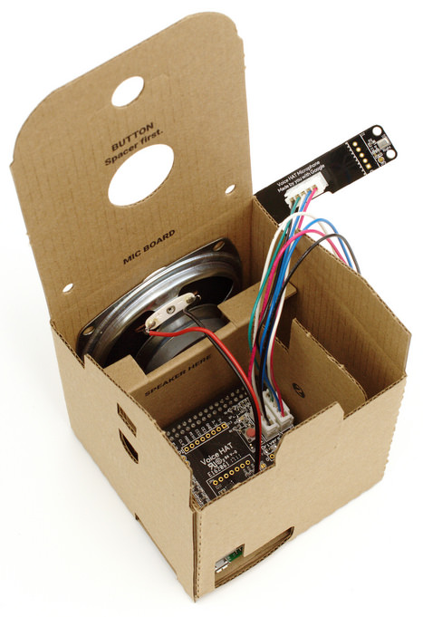
AIY - Vision + Voice
Google have kits for "Artificial Intelligence Yourself"
You can build your own using
Raspberry Pi
Cameras
Microphones
Speakers
Screen

Slide 21
ACT Open Data Portal
https://www.data.act.gov.au/
https://github.com/phillippsm/stemed-2019-data-science/blob/master/other-notebooks/posters/Journeys%20Portrait%20-%20cyclists.pdf
https://raw.githubusercontent.com/phillippsm/stemed-2019-data-science/master/other-notebooks/videos/cycle_crash_viz2.webm

Slide 22
Google Sheets + Forms Anyone
What can you achieve with Google Sheets and Google Forms?
Where can you apply them, and where do you need to go beyond?

Slide 23
Getting Dirty - Python, Jupyter, Anaconda, ...
We will work with Binder
Preferably work in pairs
You can do this in a browser: https://bit.ly/2UBeZVq
Required:
Python 3.6 or later
Anaconda (packaged) or (individually)
Jupyter
Pandas
Numpy
Matplotlib
Xarray
NetCDF4
Seaborn

Slide 24
Big Data Example
Today we will look at how Python can be used to slice big data through "lazy evaluation" using NetCDF
https://www.unidata.ucar.edu/software/netcdf/

Slide 25
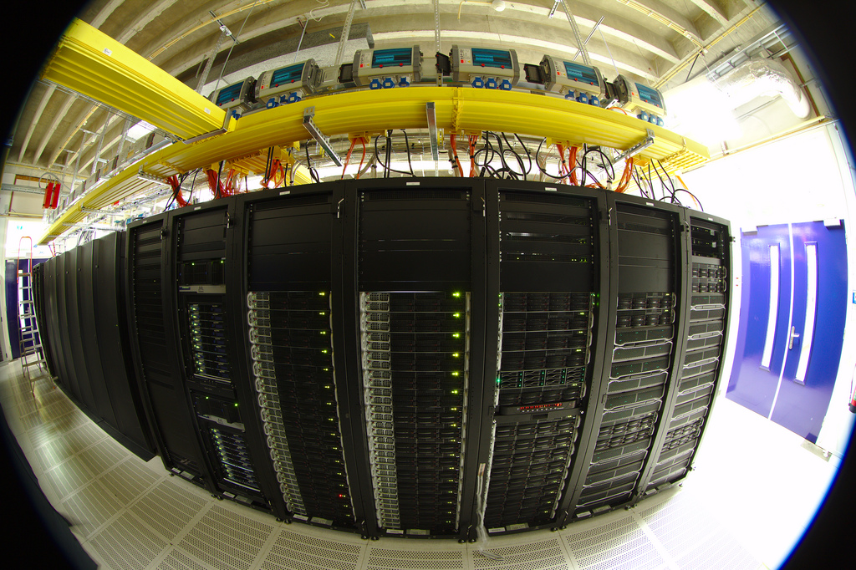
NCI
Possible excursion opportunity?

Slide 26
Getting Dirty - Machine Learning - AIY
Using the Google AIY Platform
Can we actually run an ML system on this device (Raspberry Pi mini)?
What is Matthew building in his shed?

Slide 27
Feedback Survey
https://www.surveymonkey.com/r/76GKLYG
What is Big Data and Machine Learning?
Matthew Phillipps
https://bit.ly/2JX3B2i

